Slide 1
We Can’t Consent To This campaign in response to:
Women killed or injured in violence which the accused say was part of consensual sex
Normalisation of violence against women in sex: particularly strangulation.
Approach: collect good data to communicate the scale of the issue and support law and policy changes to achieve our aims.
wecantconsenttothis.uk

Slide 2
WHO CLAIMS A “SEX GAME GONE WRONG”?
Man in death of a woman
Man in death of a man
Our data on killings of 66 UK men and women where the accused says in their defence that the victim consented.
Woman in death of a woman
Woman in death of a man

Slide 3
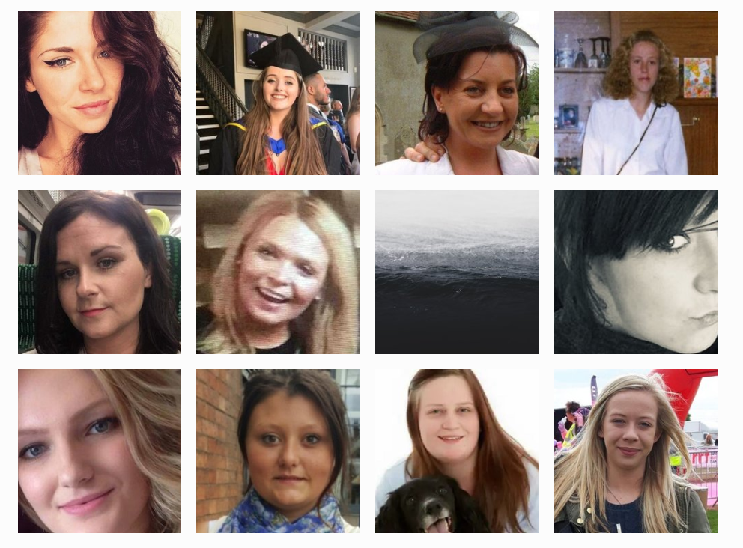
59 UK women and girls
Campaign responded to the short sentence given to Natalie Connolly’s partner in December 2018.
Since Natalie Connolly's death in 2016, these 12 other UK women have died in claimed rough sex, gone wrong.
The earliest UK case was the killing of Carole Califano in 1972: Carole had been trying to leave her abusive partner: he was convicted of her manslaughter.
We Can’t Consent To This collates data from local and national news, data projects like Counting Dead Women, appeal court findings, to bring these women’s stories together.

Slide 4
Findings: “rough sex” claims more common. Tenfold in 20 years.
In the last week, 6 UK women’s homicides or assaults have been reported:
Partner of Natalie Connolly appeals his sentence of 3 years 8 months for manslaughter
Grace Millane, from Essex – ongoing trial of man accused of her murder in New Zealand. He claims she died after rough sex.
Man in Wales accused of wounding and other assault charges – found not guilty.
37 year old man in Sunderland sentenced to 14 years for terrible violent assault on a woman – he claimed she had asked him for rough sex.
Ongoing trial of a young man accused of strangling his female partner and a girl he met on a date – he claims the latter consented to “mild strangulation”.
Significant increase in “consent” claims since 2000
Lag in data

Slide 5
Findings: these homicides mostly follow familiar patterns
31 women killed by current or ex partners. At least 20 of the relationships had previous abuse (controlling behaviour, violence), and at least 12 women had left or were trying to leave the relationship.
20 women had just met the men who killed them that day. 7 of those women were prostitutes meeting the men for paid sex. The others met the men in nightclubs, on a dating app, or through a friend.
Two thirds of the women and girls killed had been strangled. This is around 3 times higher than the average rate of strangulation in the homicide of women and girls.
At least 20 of the accused killers have other convictions for serious violence against women. These include murder, rape, attempted rape, kidnapping, assault.
In 4 of the 10 recent killings of women and girls, the men viewed “extreme” porn featuring strangulation and killing of women before or after the killing of the women.
Women 90% of the victims of killings, and 98% of injuries.
Aside from “case law” cases, all of the other sample of 100 assault cases we’ve found have a victim that says they did not consent

Slide 6
Finding: “consent” claims successful 45% of the time
Following the death of the 59 women and girls:
35 successful murder convictions. However in 3 of those cases the women’s deaths were treated as non-suspicious “sex games” until other evidence emerged – a review by a pathologist, the man murdering two other women, and the man confessing, respectively. And in 1 the “sex game” claim had an explicit sentencing benefit
16 cases resulted in manslaughter convictions, with sentences ranging from 3 years to 16 years
Of 6 no charge/not guilty: 2 men found not guilty of all charges. In 2 cases no charges were brought. In 1 case charges were dropped against the man who had confessed, as the woman’s death was determined to be a drug overdose. In 1 the man was found guilty only of dismembering her body.

Slide 7
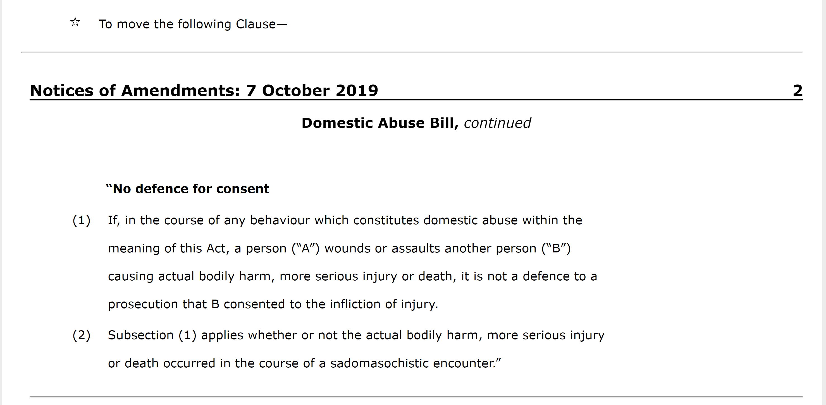
A real chance to make the law clear
Harriet Harman and Mark Garnier (the MP for Natalie Connolly’s family) and 26 other MPs proposed to add to the Domestic Abuse bill: move the R v Brown case law into statue, and also require DPP approval of lesser charges in a domestic homicide.
Must ask new MPs to bring this back after the general election.

